Slide 1
DESIGN PATTERNS
- Sanjul Lalwani

Slide 2
Agenda
Introduction
Creational Design Patterns
Abstract Factory
Factory
Builder
Prototype
Singleton

Slide 3
Introduction
Why Design Patterns ?? Knowing OOPS is not sufficient?
There is always a story…
Joe, a developer, was working on project involved with Ducks. He had a base class which define all that is needed for a duck. One day, he got a change request to provide a flying ability to some of the Ducks.
So what should he do??
Well he added that requirement in base class… Problem solved (temporarily)
But this made a big issue with how system has been designed for any type of duck..

Slide 4
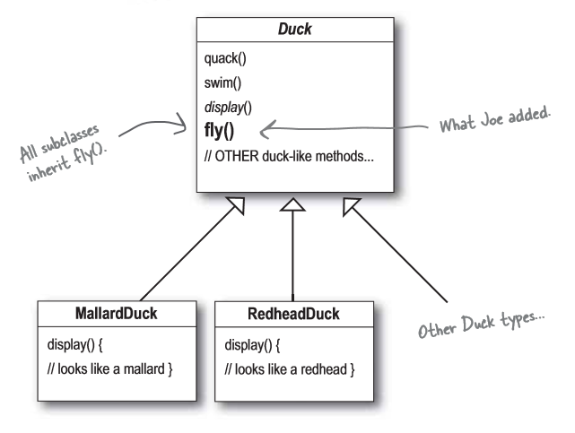

Slide 5
Intro…(cont)
That’s why we need a strategy to put forward before the actual WAR.
GOF – Gangs of Four
Erich Gamma
Richard Helm
Ralph Johnson
John Vlissides
3 Major classification : Creational, Structural, & Behavioral
23 patterns in above 3 groups.

Slide 6
Creational Design Patterns
Below patterns deal with the process of objects creation in such a way that they can be decoupled from their implementing system.
provides flexibility in deciding objects creation for a given use case/ scenario.
Classification as follows:
Abstract Factory : Create instances of several classes belonging to different families
Factory Method : Create instances of derived classes
Builder : Separates an object construction from its representation
Prototype : Create a duplicate object or clone of the object
Singleton : Ensures that a class can has only one instance

Slide 7
Abstract Factory
Provide an interface for creating families of related or dependent objects without specifying their concrete classes.
Mostly deals with base class, which makes it easier to plug-in new derived objects
Even this slideshow is an example of Abstract factory..
Lets have a demo..

Slide 8
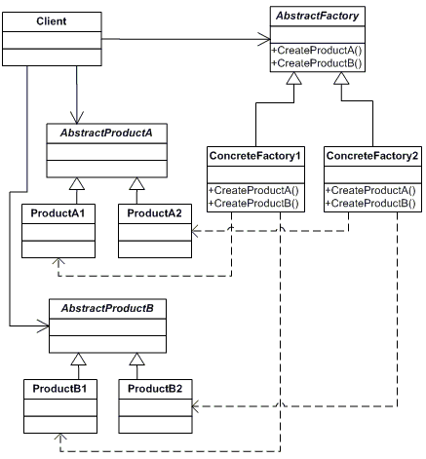

Slide 9
Factory
Define an interface for creating an object, but let subclasses decide which class to instantiate.
Factory Method lets a class defer instantiation to subclasses.
Lets have a demo..

Slide 10
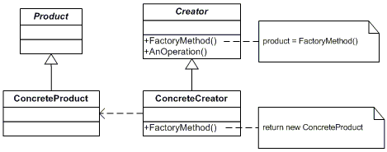

Slide 11
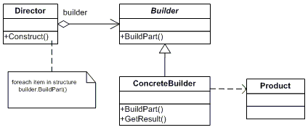
Builder
Separate the construction of a complex object from its representation so that the same construction process can create different representations.
Reusability is achieved as construction logic is taken out.
Lets have a demo..

Slide 12
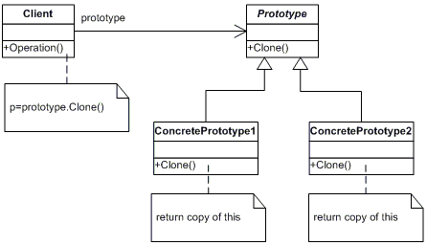
Prototype
Specify the kind of objects to create using a prototypical instance
And create new objects by copying this prototype.
Lets have a demo..

Slide 13

Singleton
Ensure a class has only one instance and provide a global point of access to it.
Like Configuration Manager, or Custom State Server Management for an application
Lets have a demo..

Slide 14
Any Question???

Slide 15
Reference and study material
http://www.dotnettricks.com/learn/designpatterns/gang-of-four-gof-design-patterns-in-net
https://csharpdesignpatterns.codeplex.com/
http://www.dofactory.com/net/design-patterns

Slide 16
Thanks…
See you soon…

